Slide 1

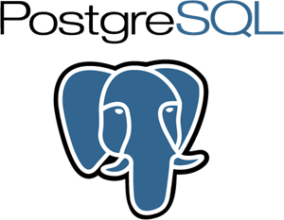
SQL

Slide 2

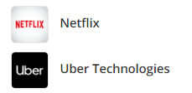
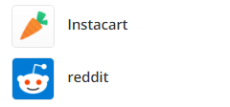
What is PostgreSQL
PostgreSQL is an advanced object-relational database management system that supports an extended subset of the SQL standard, including transactions, foreign keys, subqueries, triggers, user-defined types and functions.
PostgreSQL
Companies using PostgreSQL

Slide 3
Why PostgreSQL
Completely Open source
Complete ACID Compliance
Comprehensive documentation and active discussion forums
PostgreSQL performance is utilized best in systems requiring execution of complex queries
PostgreSQL is best suited for Data Warehousing and data analysis applications that require fast read/write speeds
Supported by all major cloud service providers, including Amazon, Google, & Microsoft
Why PostgreSQL

